Slide 1

WARIS
OM SINGH
ARKAPRABHA
DSP-Aware
Convolutional Autoencoder for Satellite Image Compression
in 5G Network Slicing
PRESENTED TO :
Dr. Sukhwinder Singh,
Dr. Gourab Das,
Dr. Satinder Singh Mohar,
Dr. Ashish Singh
SUPERVISORS :
Dr. Deepak Bagai and Dr. Ashish Singh

Slide 2


DSP-Aware
Convolutional Autoencoder for Satellite Image Compression
in 5G Network Slicing

Slide 3
DSP-Aware
Convolutional Autoencoder for Satellite Image Compression
in 5G Network Slicing
Deep Learning model to achieve high-fidelity satellite image compression, outperforming traditional mathematical codecs like JPEG. It leverages 5G Network Slicing to ensure the efficient, secure, and ultra-reliable transmission of critical remote sensing data.

Slide 4
Problem
PROBLEM
The Standard JPEG compression relies on the Discrete Cosine Transform (DCT), which aggressively suppresses high-frequency components essential for satellite imagery . It applies a static algorithm that fails to adapt to the complex, pixel-sized details found in small 64x64 satellite patches.
Origin of the idea
01
Inspired by the success of Autoencoders in text processing (LLMs) and Convolutional Neural Networks (CNNs) in vision, we hypothesized that Convolutional Autoencoders could learn non-linear transforms superior to fixed mathematical ones .
ORIGIN OF THE IDEA

Slide 5
Design a deep learning-based image compression model using DSP-aware convolutional autoencoder.
01.
OBJECTIVE
Implement a "frequency-aware" loss function guided by DCT and Perceptual Loss to preserve scientifically critical features .
02.
The objective is to design a DSP-aware convolutional autoencoder that outperforms JPEG by preserving critical high-frequency satellite details using a custom frequency-aware loss function . Additionally, we aim to implement 5G Network Slicing to optimize transmission, segregating bulk image data into high-throughput eMBB slices while securing vital decoding keys in ultra-reliable URLLC slices
02
Implement 5G slicing by sending high-volume image data through eMBB while routing decoding keys through URLLC.
03.

Slide 6

03
NOVELTY
Dr. C Krishna Mohan
Professor, IIT Hyderabad
Dr. Ashwani Sharma
Associate Professor, IIT Ropar
UNCERTAINITY
Dr. Sukrit Gupta
Assistant Professor, IIT Ropar
Kamanksha Prasad Dubey
HYPERPRIOR
AUTOENCODER
PhD Student, IIT Indore

Slide 7
04
Sophisticated Architecture
DSP-Informed Loss Function
AI
DESIGN
We implemented a custom SatelliteVBR class utilizing GDN (Generalized Divisive Normalization) layers for statistical Gaussianization and CustomAttentionBlock to focus the encoder on high-frequency satellite textures .
To preserve structural fidelity, we integrated a special VggPerceptualLoss function that optimizes feature extraction (using VGG19 layers) rather than simple pixel minimization, forcing the AI to respect perceptual edges
Mathematical Stability
Compute & Training
The model incorporates critical DSP stability fixes, such as replacing standard ReLUs with LeakyReLU and using torch.exp(log_scale) to prevent numerical divergence (NaN errors) during probability estimation
Training was conducted on Google Colab T4 GPUs over 15 - 20 days, requiring 5–10 iterative checkpoints and different AI models to stabilize the complex variable-bit-rate gain units .

Slide 8
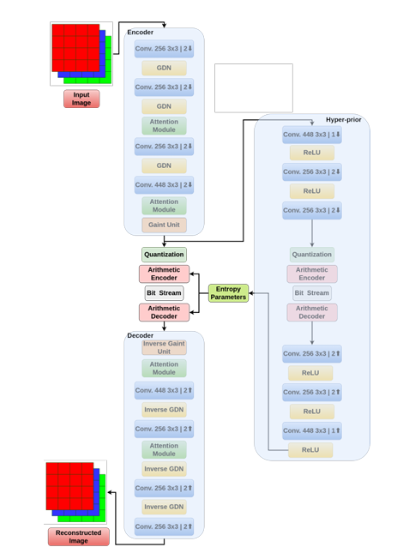
05
ARCHITECTURE
The model employs a sophisticated two-stream architecture that generates distinct probability vectors based on entropy estimation. This process separates the output into a bulk vector y, containing the heavy latent visual data, and a key vector z, a tiny probability index acting as side information to instruct the decoder. By decoupling the "Key" (z) from the "Bulk" (y), the system effectively models the image's probability distribution, thereby minimizing the bit-rate while simultaneously maximizing reconstruction quality.

Slide 9
5G
Network Slicing
eMBB Slice
Uses high-throughput 64-QAM modulation to transmit the bulk image vector y
URLLC Slice
06
Uses robust QPSK modulation to ensure the critical probability key z is never lost, even in poor signal conditions

Slide 10
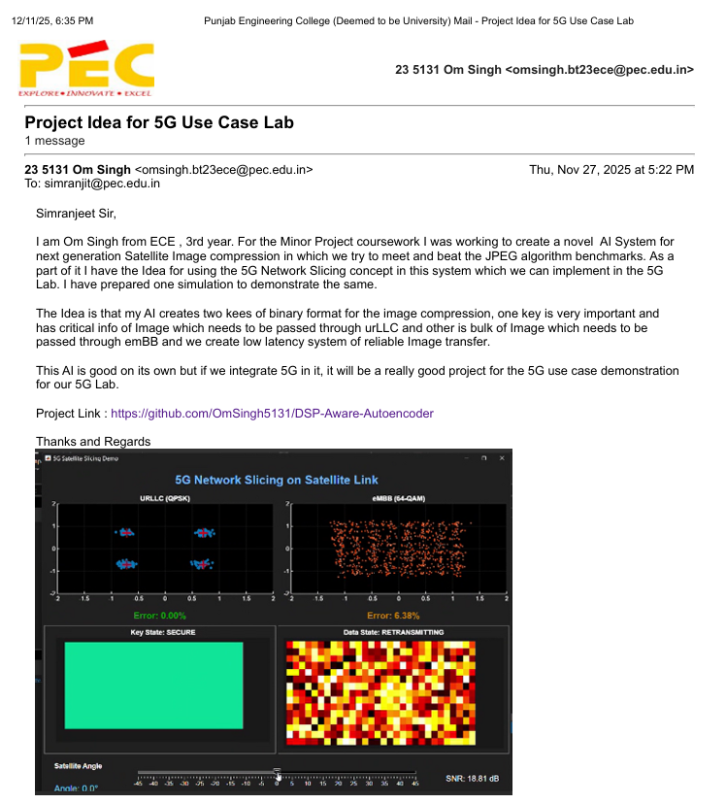
5G
Network Slicing
06

Slide 11
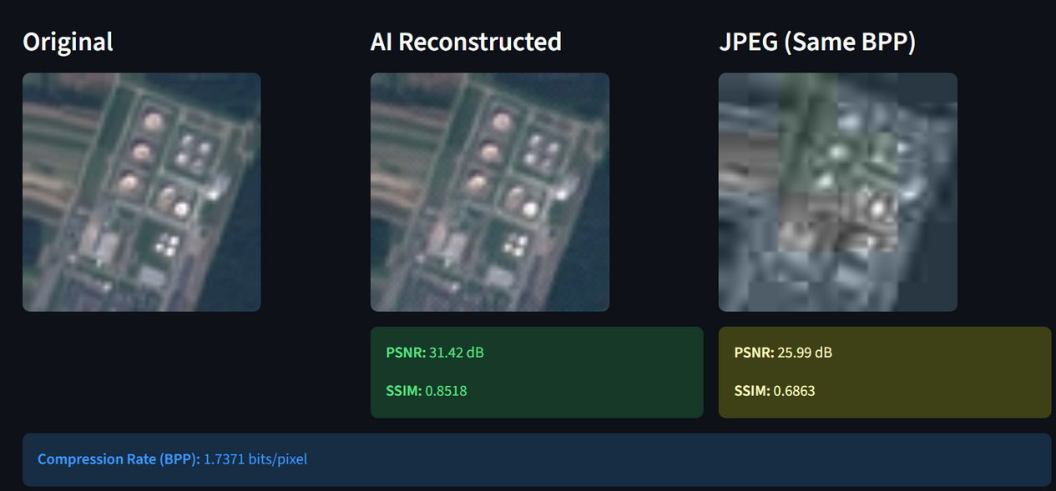
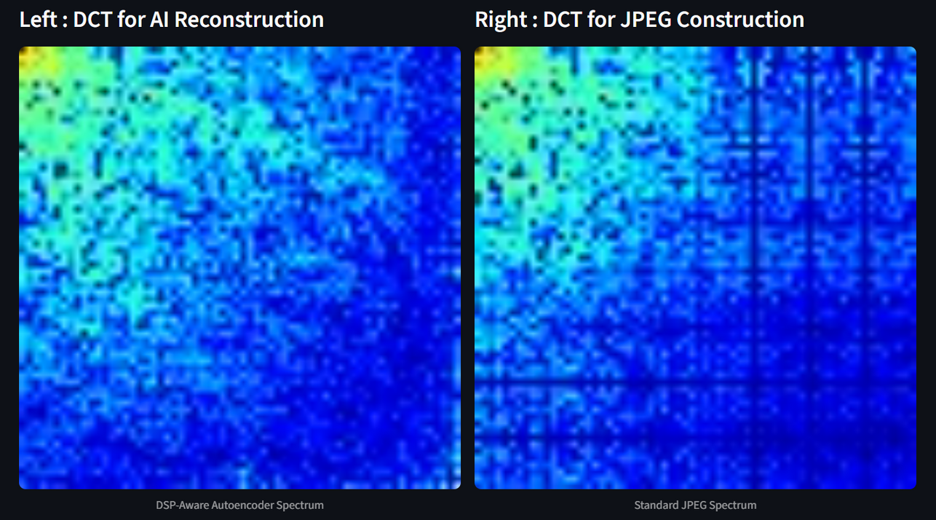
07
RESULTS

Slide 12
LIVE DEMO...

